Slide 1
Searching the provider databases

Slide 2
How to use this slide deck
These slides are designed to form the backbone of your group and individual training sessions and to be inclusive advanced searchers with a range of experience
Please take what you need from this deck, hide the slides you don’t want, tailor the content to your sessions and apply your own branding
The slide deck is arranged into the following sections
Aims and objectives
Principles of literature searching – answering different types of question
Pointers for different audiences/specialties
General concepts
Making the most of each platform
EBSCOHost
Ovid
ProQuest
Managing and reporting on your search results

Slide 3
Aims and objectives
The aim of this workshop is
By the end of this session you will be able to:
Recognise when you need to conduct a search
Identify appropriate resources relevant to your search topic
Develop a search strategy to guide your search
Apply your strategy to appropriate resources
Refine your search
Manage outputs from your search

Slide 4
Principles of searching

Slide 5
What is a literature search?
An organised search to find information relevant to your question
To do a good literature search you will need to:
Define your question
Decide where to look for information
Develop a search strategy
Apply your search strategy to your chosen resources
Refine your strategy
Save your results
Document your search process
Searching is a craft – it takes time to do it well!

Slide 6
Defining your question
Having a clearly defined question will help you to structure your search
It will also make it easier to decide which of your search results you want to keep
Use a recognised model to help you define your question and identify searchable elements

Slide 7
Search models
PICO
SPICE
Patient | People with gestational diabetes
Intervention | Diet and exercise
Comparison | Insulin
Outcome | Healthy pregnancy and birth
Setting | In a lunch club for seniors
Perspectives | From the perspective of participants
Intervention | How do in situ health checks
Comparison | Compare with practice-based appointments
Evaluation | In engagement with the annual health check programme
Notes:
Provide a worksheet on alternative models?

Slide 8
Now list synonyms, antonyms, acronyms etc
Patient | People with gestational diabetes | Fasting plasma glucose = 5.4mmol/L
Intervention | Diet and exercise | Lifestyle modification, low glycaemic index, low GI
Comparison | Insulin | Metformin
Outcome | Healthy pregnancy and birth | Reduced risk of fetal and maternal adverse outcomes including macrosomia, neonatal hypoglycaemia, hyperbilirubinaemia, hypocalcaemia, gestational hypertension, pre-eclampsia, caesarean delivery

Slide 9
Where should I look?

Slide 10
That depends on the type of question
Clinical decision support | I need to refresh my knowledge of a clinical topic before I see the next patient | BMJ Best Practice
Quick overview | I need to find a couple of articles to include in an internal team presentation | NHS Knowledge and Library Hub
Doing an academic course | I need a couple of text books and some academic literature to cite in my coursework | Library catalogue and bibliographic databases
Developing a local management policy | I need to know the current and previous policies, what similar organisations have in place and some published articles from the management literature | Corporate knowledge, grey literature, management literature
Developing a clinical guideline | I need to know what national and international guidelines are in place and I want an update on any high quality evidence on the topic that has been published more recently | Trip, Cochrane Library, bibliographic databases
Informing research | I need to know what has been published in my field and what research is already underway | Bibliographic databases, research registers
Systematic review | I need all the evidence relating to my protocol | Bibliographic databases, Cochrane Library, Campbell Collaboration, research registers, research repositories

Slide 11
And the topic area…

Slide 12
Sources of mental health evidence
Generalist resources including Medline, Embase, CINAHL, Trip
Plus
PsycInfo
Psychology and Behavioral Sciences Collection (full text)
PsycArticles (full text)
Social Policy and Practice
Campbell Collaboration
PTSDPubs

Slide 13
Sources of management and corporate evidence
Generalist resources including Medline, Embase, CINAHL, Trip
Plus
Healthcare Management Information Consortium
National Grey Literature Collection
Health Research Premium Collection (full text)

Slide 14
Sources of nursing and midwifery evidence
Generalist resources including Medline, Embase, CINAHL, Trip
Plus
Emcare
British Nursing Index

Slide 15
General search concepts
Notes:
The following general principles apply to most searching. Most databases offer some flavour of these functions but they may be labelled slightly differently from one resource to the next.

Slide 16
Textwords, keywords and subject headings – what’s the difference?
Textword refers to the exact string of characters to that makes a work in the title, abstract or other part of the record. A textword search will retrieve items which use exactly that combination of characters. For example, a textword search for “schizophrenia” will not retrieve articles which refer to “psychosis” instead
Keywords are usually assigned by authors. A combination of keywords will give the reader a sense of the whole paper. But keywords are very subjective and different authors my use different keywords for the same concept
Subject headings are often applied to records in commercial databases. They are taken from a controlled vocabulary, or a taxonomy. By using terms from a defined list, subject headings can overcome the variation between authors in choice of terminology. For example, in PsycInfo searching for Psychosis as a subject heading will retrieve schizophrenia, postpartum psychosis and so on

Slide 17
Apply your search terms
Apply them one at a time
Search for relevant subject headings
Use the hierarchy of subject headings to navigate to the most suitable term
Don’t forget to search for textwords as well
You can make textwords more flexible by using wildcards eg to replace different word endings eg child* will retrieve child and children and childhood
You can also make textword searching more specific by using phrases eg “community care” will retrieve fewer results than community care

Slide 18
Combining sets
What pets does your household have?
3
1
Cats
Dogs
2
Notes:
Each line of a search is usually a stand-alone search. To bring these together into a complex search that will better answer your question, you will need to combine the sets.
Do this with Boolean operators:
AND – gives you the intersection of two sets.
OR – gives the combined inclusion of two sets. As a prompt that you get bigger numbers when you us OR, remember that “OR means MORE”
NOT – gives the remainder of one set when the other is removed. NOT is not used frequently but can be a powerful tool for removing records which aren’t relevant to your search
QUIZ!
What does the segment marked 1 show?
What operator will give you the combined ownership of all pets?
What is in the segment marked 3?

Slide 19
Refining your search – using limits
Most databases offer a range of options for limiting your search results.
Publication date
Language of the article
Population age range (infant, child, adult)
Full text availability
Publication type (RCT, review etc)
Notes:
Hint – “country of publication” isn’t always helpful. To find research relating to the UK, use a search hedge.
Hint – searching for diversity or ethnicity? Use a search hedge

Slide 20
Reviewing and saving your results
Most platforms allow you to mark your favourite items, adding them to a clipboard or folder as you go through sets of results
You will then be able to export or save your results by:
Emailing them to yourself
Opening or saving them in a document format (eg Word, Excel or PDF)
Saving them to a reference management package
A reference management tool is helpful especially if you use multiple databases, need to cite references in your own documents or manage several projects. Reference management tools include:
Subscription: EndNote, RefWorks
Free to use: Mendeley, Zotero

Slide 21
Saving and documenting your search history
It is good practice to keep a record of what you searched, and when
This saves time if you have a similar enquiry in future
It also shows the steps you took to find your information
Other people may want to reproduce your search
Most platforms allow you to save your search history as a long-term record
You may also want to use your saved searches to send you alerts when new material is added
If you are conducting a systematic review, familiarise yourself with the PRISMA Statement

Slide 22
Which interfaces do I need?
Interface provider | Databases
EBSCO Host | CINAHL, Medline, Psychology and Behavioral Sciences Collection
Ovid | AMED, Embase, Emcare, HMIC, Medline, Social Policy & Practice
ProQuest | AMED, BNI, Medline, PsycInfo
Links to these databases can be found here:
https://library.nhs.uk/knowledgehub/resources-for-advanced-searching/
Login with your NHS OpenAthens account but you may need a platform account for advanced features
Notes:
Medline is available on all platforms as well as PubMed

Slide 23
Making the most of EBSCO Host

Slide 24
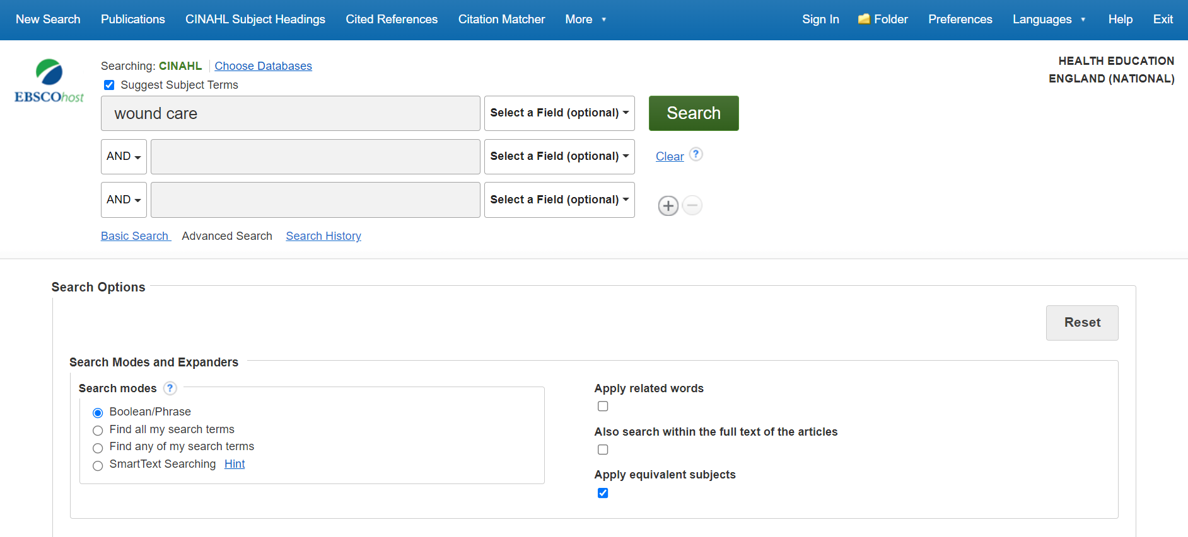
Searching by subject heading
Notes:
To search for a subject heading, tick the Suggest Subject Term box and key your term into the search field. Click search

Slide 25
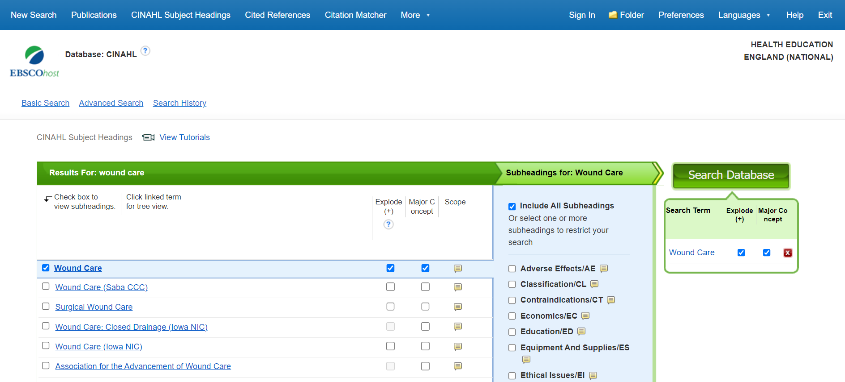
Notes:
Find your preferred term in the list of subject headings.
If you’re in doubt, use “Scope” to check the definition.
Use “Explode” to include all narrower terms in your search (in this case Wound Care plus debridement, leach therapy, negative pressure wound therapy and surgical wound care)
Use “Major Concept” if you only want to retrieve articles where this is the main topic of the paper
Use “Subheadings” to specify eg Education/ED (about Wound Care) or Ethical Issues/EI (about Wound Care)
Click “Search Database” when you’re done

Slide 26
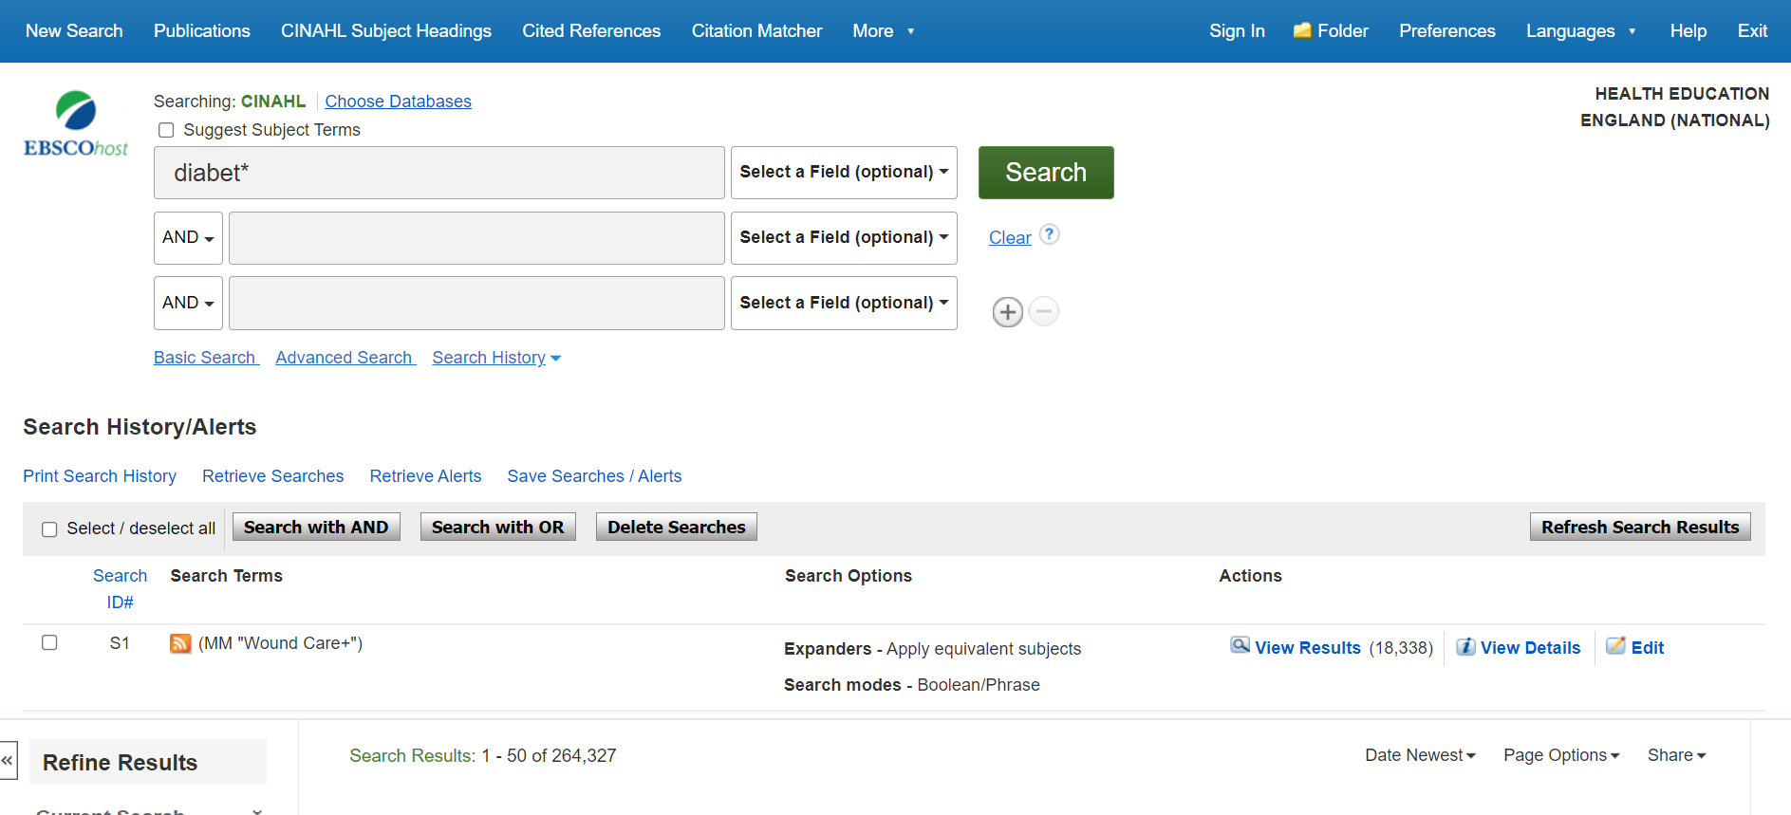
Textword searching
Notes:
Key your textword into the search box
Use * to replace letters at the end of the word, in this case to search for “diabetic” or “diabetes”
Click search

Slide 27
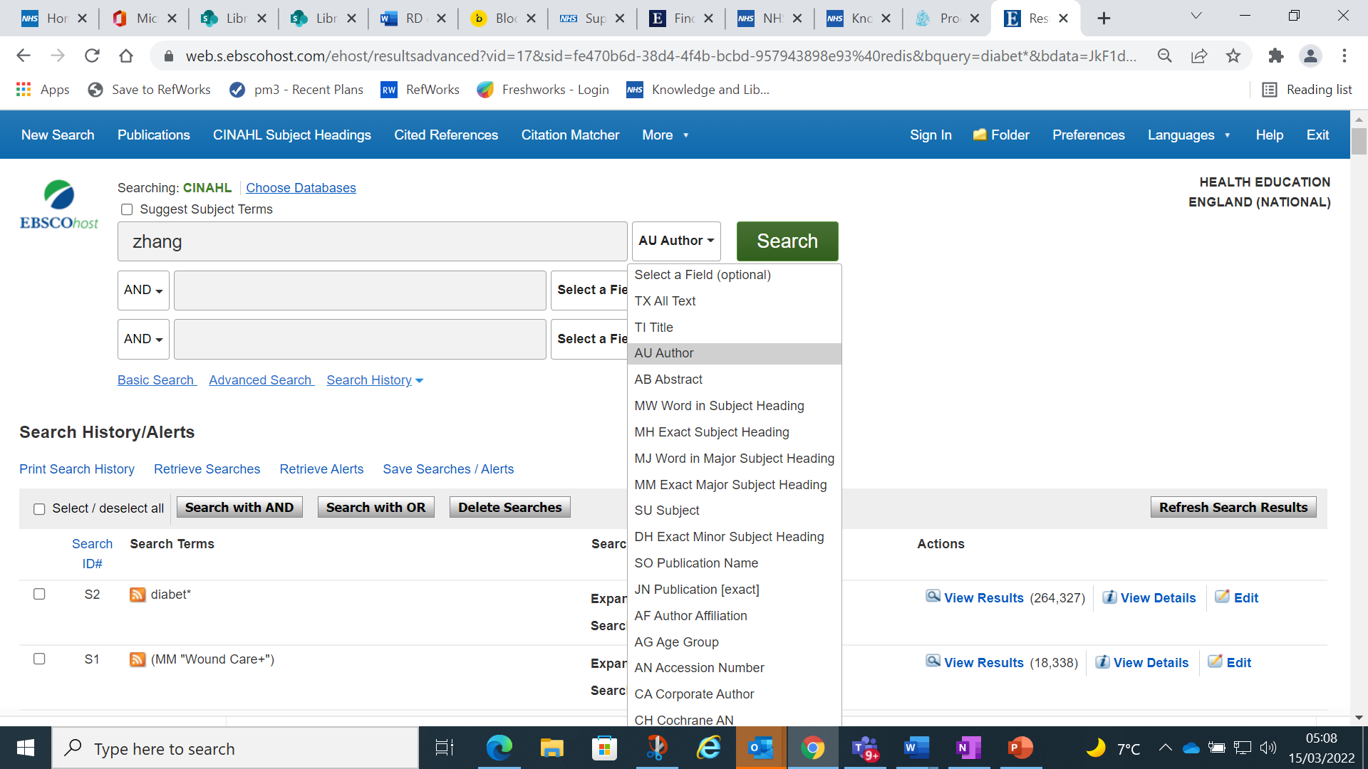
Search by field (eg Author)

Slide 28
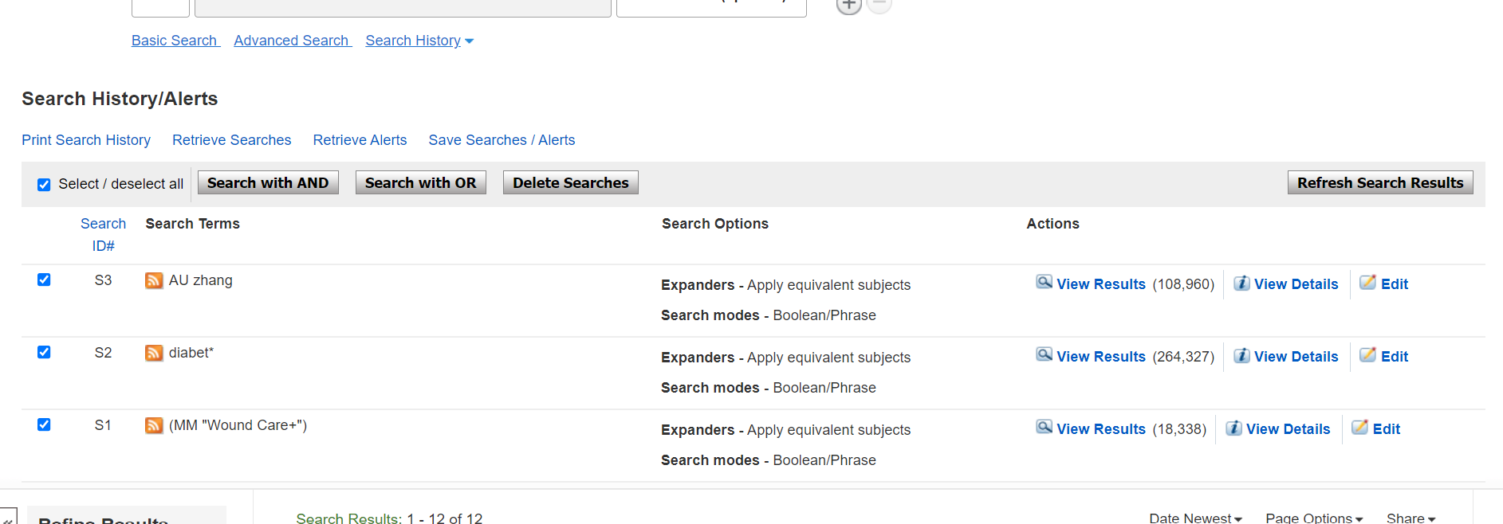
Combining your searches
Notes:
Select the searches you want to combine
To use AND or OR, click the relevant button
In this case we want to retrieve articles by Zhang on wound care in diabetes so we’re asking for 1 AND 2 AND 3
To use NOT, key the search into the search box in this format eg: (S1 AND S2) NOT S3

Slide 29
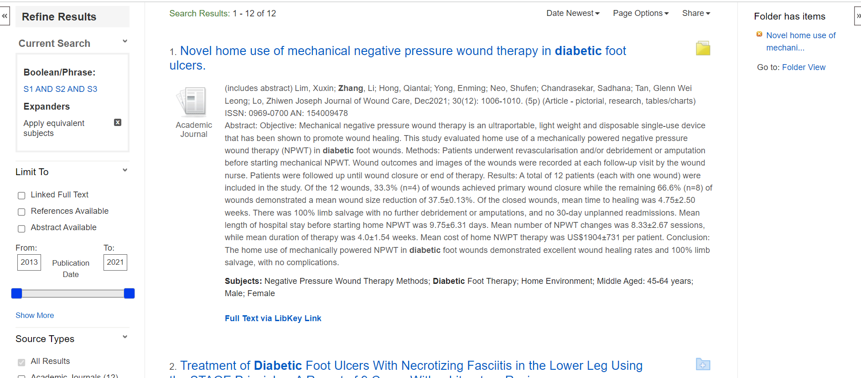
Refining and reviewing your results
Notes:
Use the limits on the left hand side to refine your results eg by date range, language etc
Click on the folder icon to save your preferred records to your folder. (You will need to sign in to your EBSCO platform account to access this feature.)
Click “Full Text via LibKey Link” to access the full text. If you are eligible to access the full text online, you will do so. If online isn’t available, use the “Request this item” link on the next page to place a document supply order with your library.

Slide 30
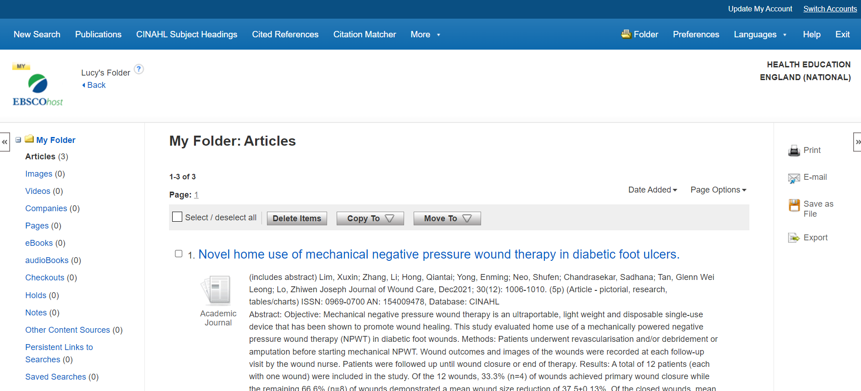
Saving your records
Notes:
Go to your Folder
Us the options down the right-hand side to export your results:
Print
Email
Save
Export (including direct to EndNote or RefWorks reference management)

Slide 31
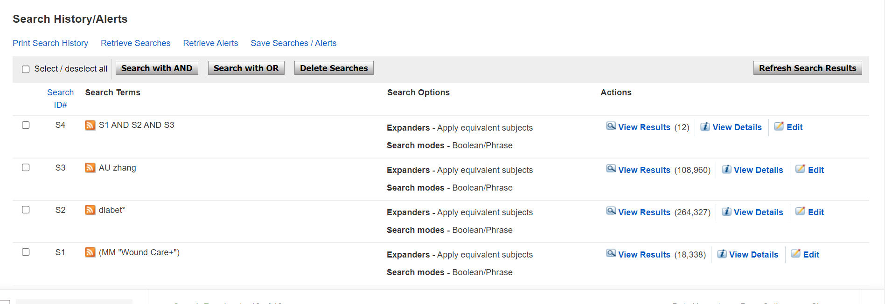
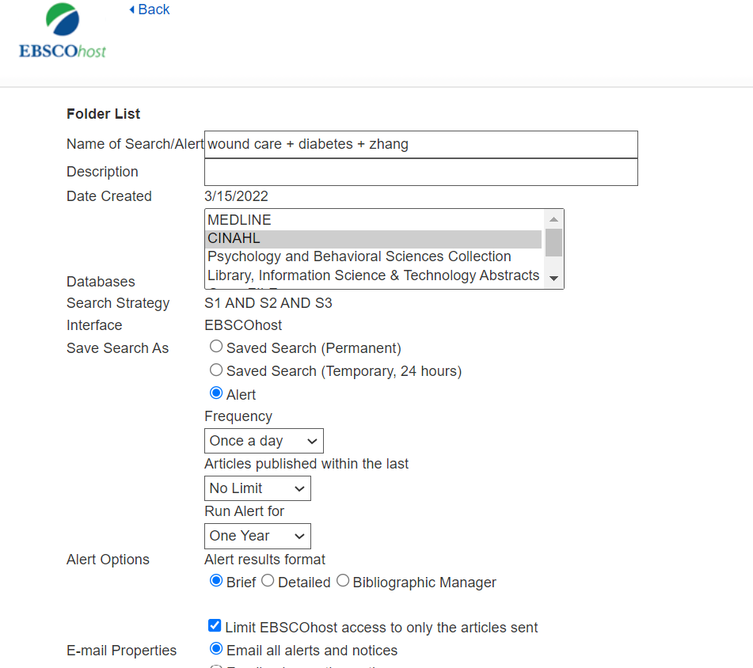
Saving your search history
Notes:
Save your search history either:
Permanently
Temporarily
Or as an alert – the database will email you when any new items matching your search are added

Slide 32
Making the most of Ovid

Slide 33
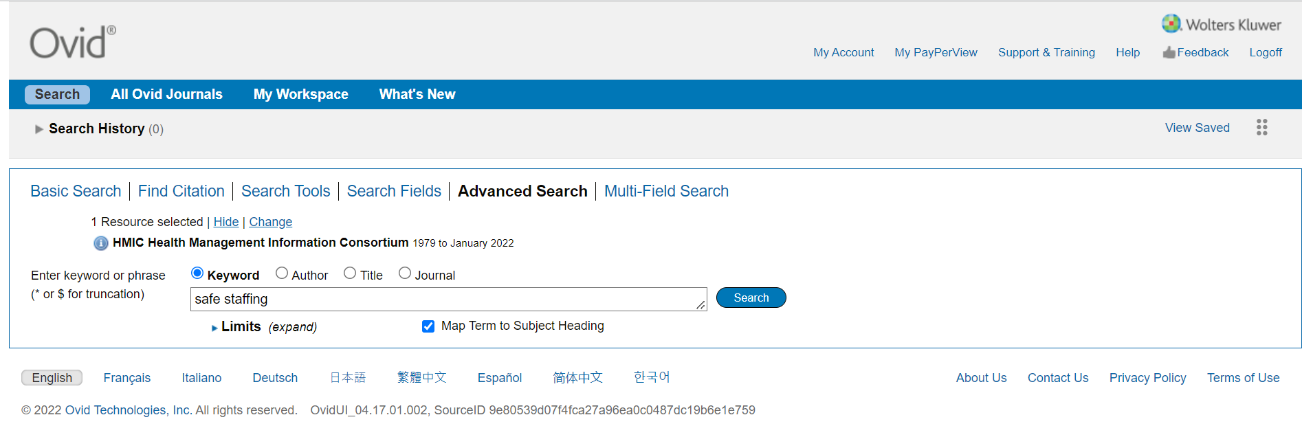
Searching by subject heading
Notes:
(Make sure you’re starting in Advanced Search)
To search for a subject heading, tick the Suggest Subject Term box and key your term into the search field. Click search

Slide 34
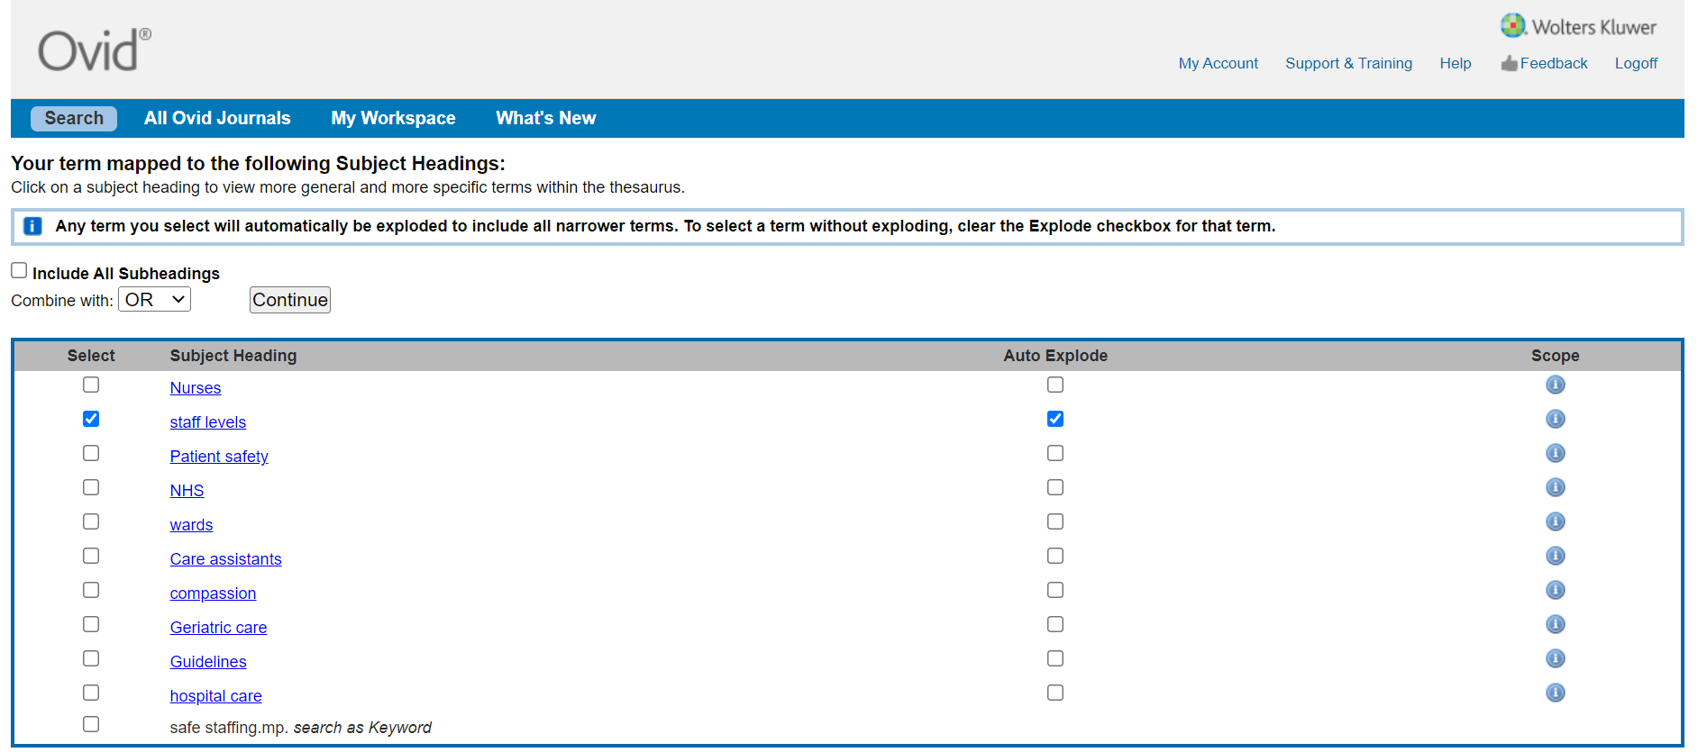
Notes:
Find your preferred term in the list of subject headings.
If you’re in doubt, use “Scope” to check the definition.
Use “Auto Explode” to include all narrower terms in your search
In some databases (eg Medline) you can use “Major” if you only want to retrieve articles where this is the main topic of the paper
In some databases (eg Medline), “Subheadings” can be used to further define a subject heading eg surgery or drug therapy for a condition. If you want to include all subheadings, tick Include All Subheadings. (HMIC does not include subheadings.)
Click “Continue” when you’re done.

Slide 35
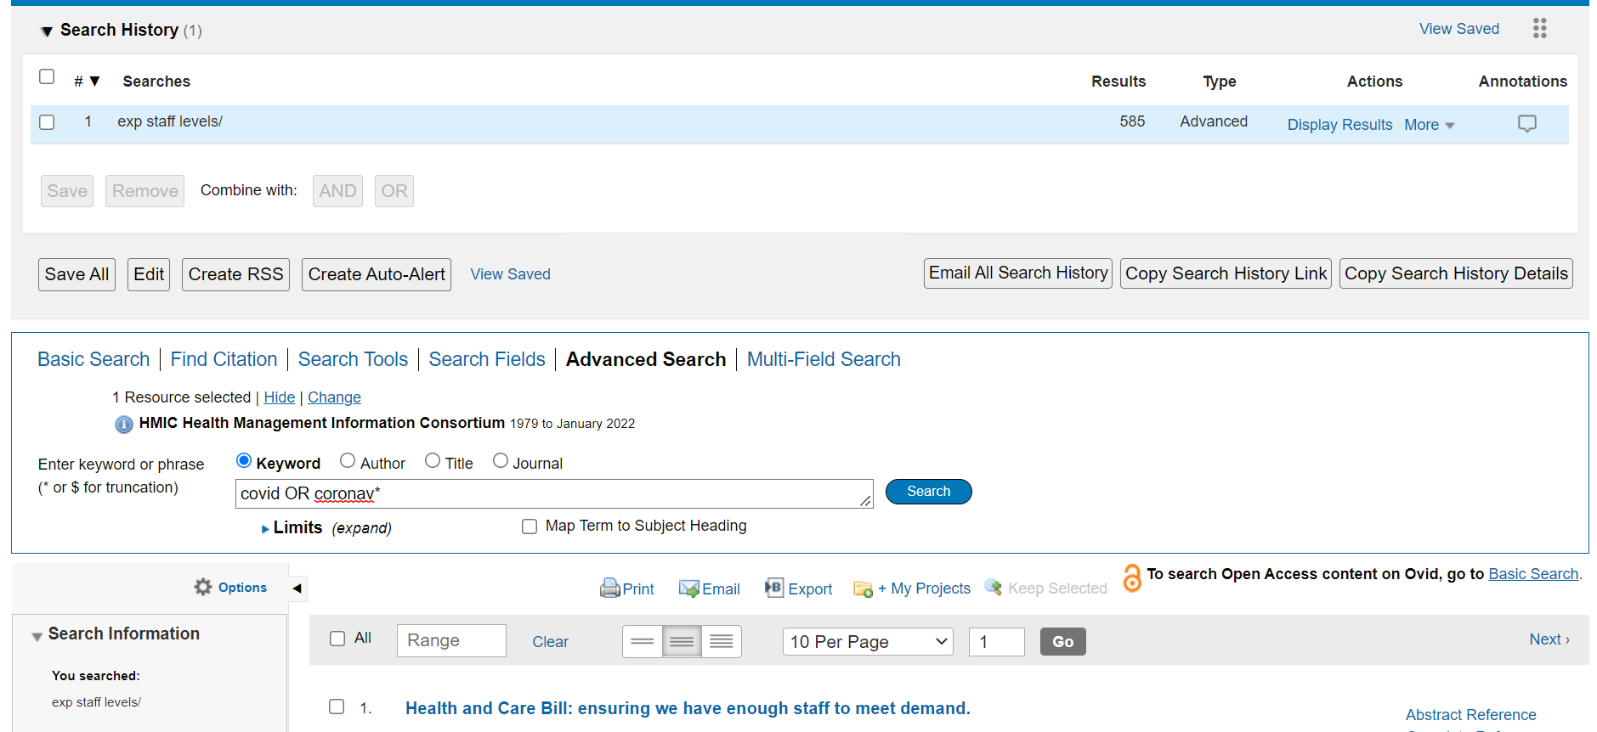
Textword searching
Notes:
Key your textword into the search box
Use * to replace letters at the end of the word, in this case to search for coronavirus
Click search

Slide 36
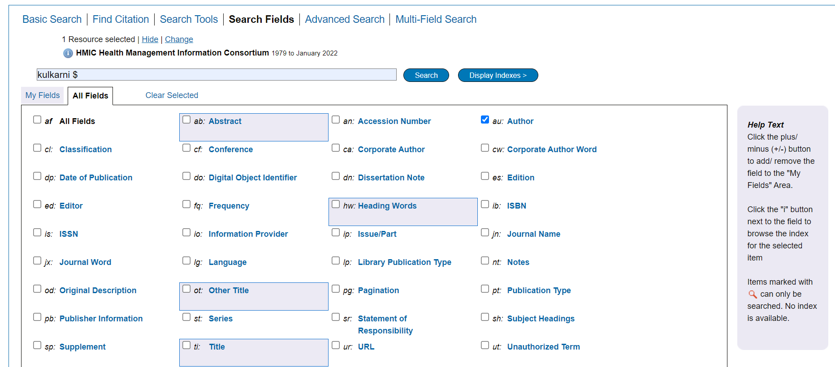
Search by field (eg Author)
Notes:
On the main search page, use the radio button to search common fields including Author, Title and Journal. But remember you need to be exact with your search term when using this option (eg include Surname and initials to find the author).
Alternatively, go to Search Fields for a full list of all the fields in this database. For an author search, key your author’s surname into your search box. If your not sure of your authors forenames, use $ to retrieve all items which include that surname and click Search. Or click Display Indexes to go to the author index and select from there.

Slide 37
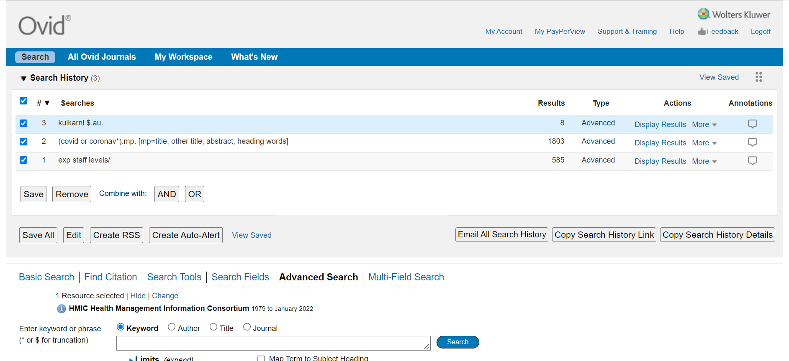
Combining your searches
Notes:
Use the drop down arrow to reveal your search history
Select the search lines you want to combine then pick AND or OR
To use NOT, or to combine search lines in different combinations, key your instruction into the search box in this format eg (1 and 2) not 3

Slide 38
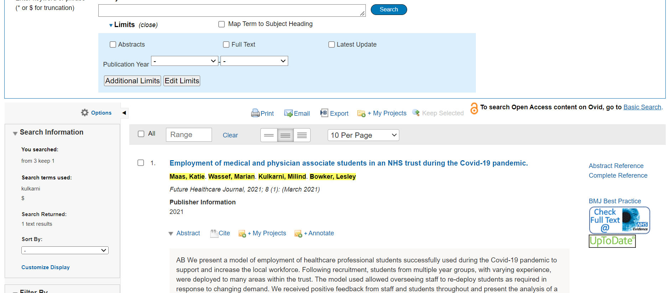
Refining and reviewing your results
Notes:
Use the drop down menu below the search box to apply limits. HMIC has very few limits but other databases have a wider range.
Use the Abstract arrow to reveal the abstract.
Lot into your Ovid platform account to save items to My Projects and to add your own notes and annotations
Click the link on the right-hand side to retrieve full text. NB this link will change to a LibKey link before 31/3/22.
Use Print, Email and Export to save your selected results for later. Export includes standard output formats for reference management packages.

Slide 39
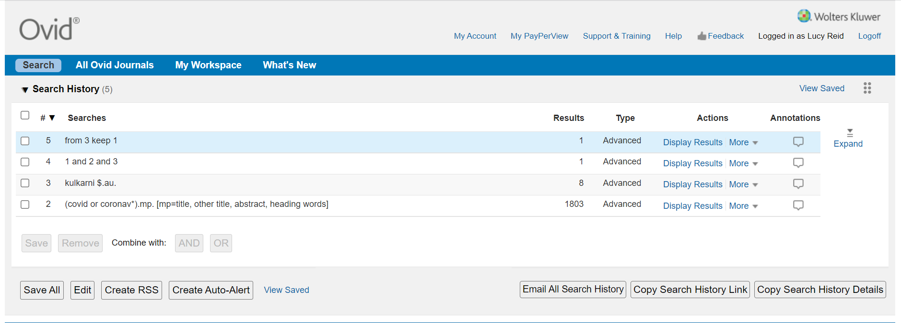
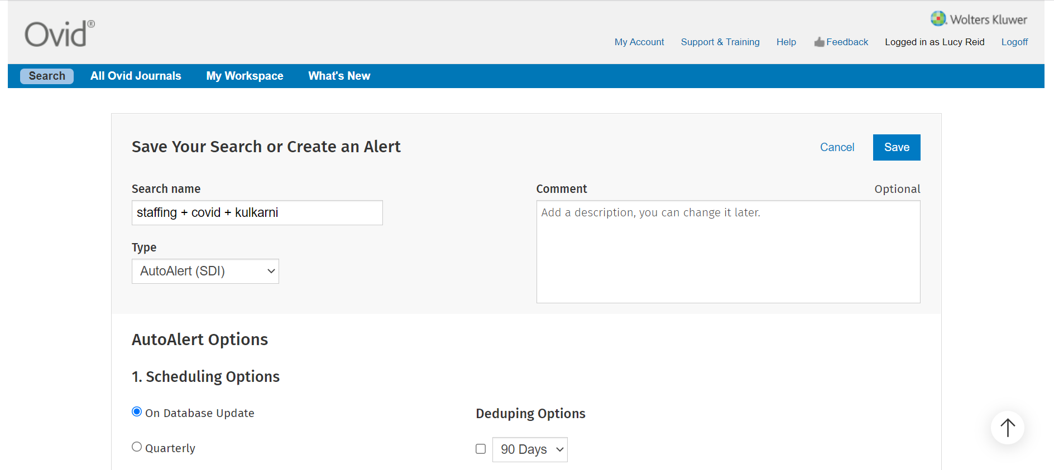
Saving your search history
Notes:
Save your search history or set up an Auto-Alert which will send you an email when any new material matching your search is added to the database

Slide 40
Making the most of ProQuest

Slide 41
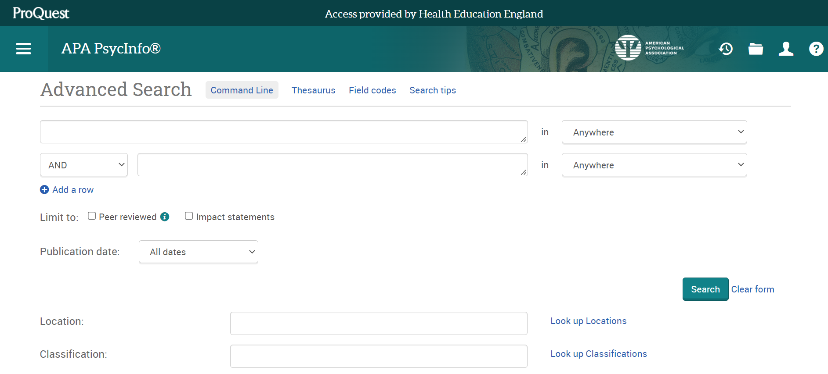
Searching by subject heading
Notes:
In Advanced Search, go to Thesaurus

Slide 42
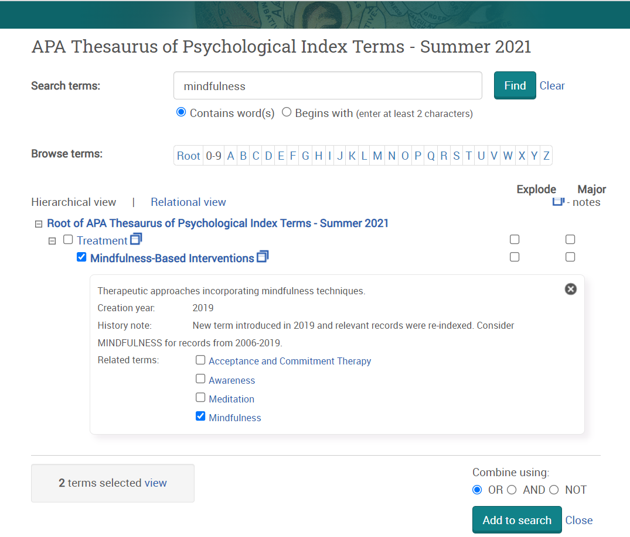
Notes:
Key in your term and click Find
Use the scope note to find out more about the term
Use the hierarchy of subject headings to navigate to the one which best fits your search or pick related items from the scope. To add related terms, combine using OR. To remove unrelated terms, combine using NOT.
Use “Explode” to include narrower subject headings
Use “Major” to retrieve articles in which this is the main topic
When you’re done, click Add to search

Slide 43
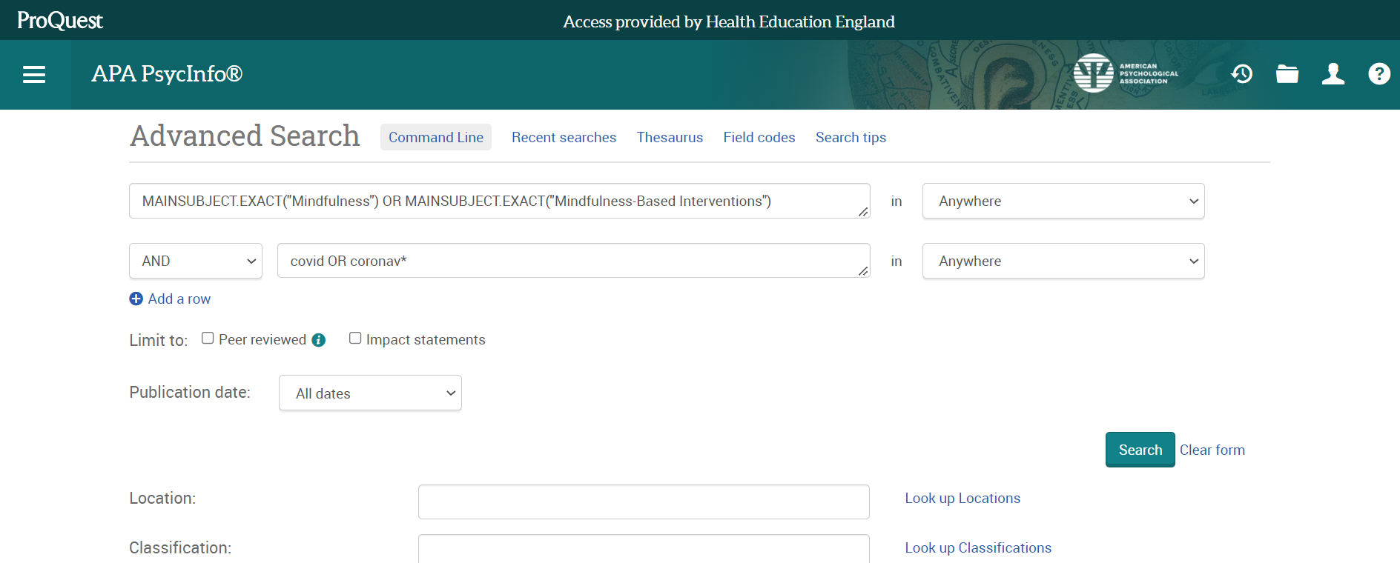
Textword searching
Notes:
When you click Add to search from the thesaurus, you will return to the main screen where you’ll see your subject term(s) in the first search box.
You can go straight on and add in other terms at this stage. To do so, key your additional terms into the next search box, adding new rows if you need more. For each row, pick the operator (AND, OR or NOT) appropriate to the way you want to combine your sets.
In this example, the second line is a textword search for covid OR coronavirus

Slide 44
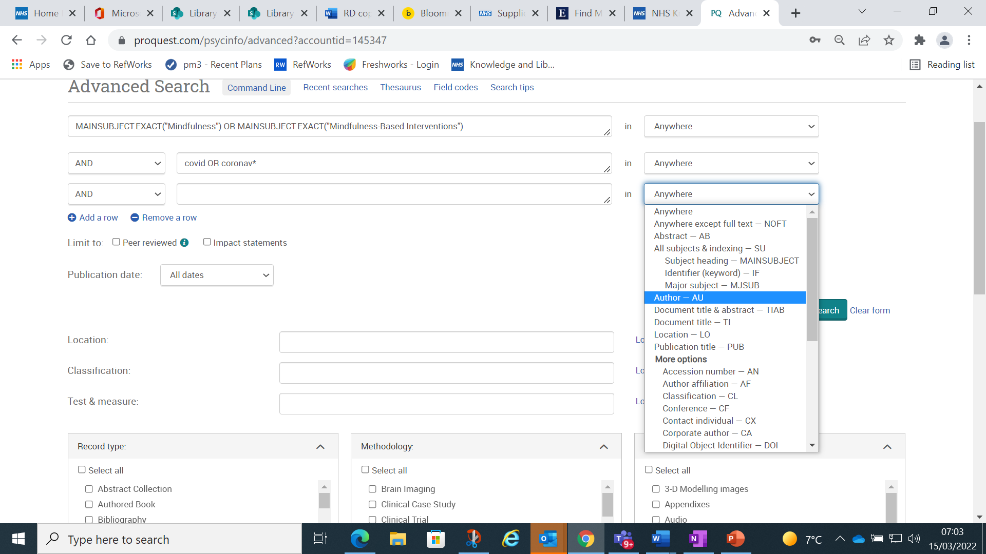
Search by field (eg Author)

Slide 45
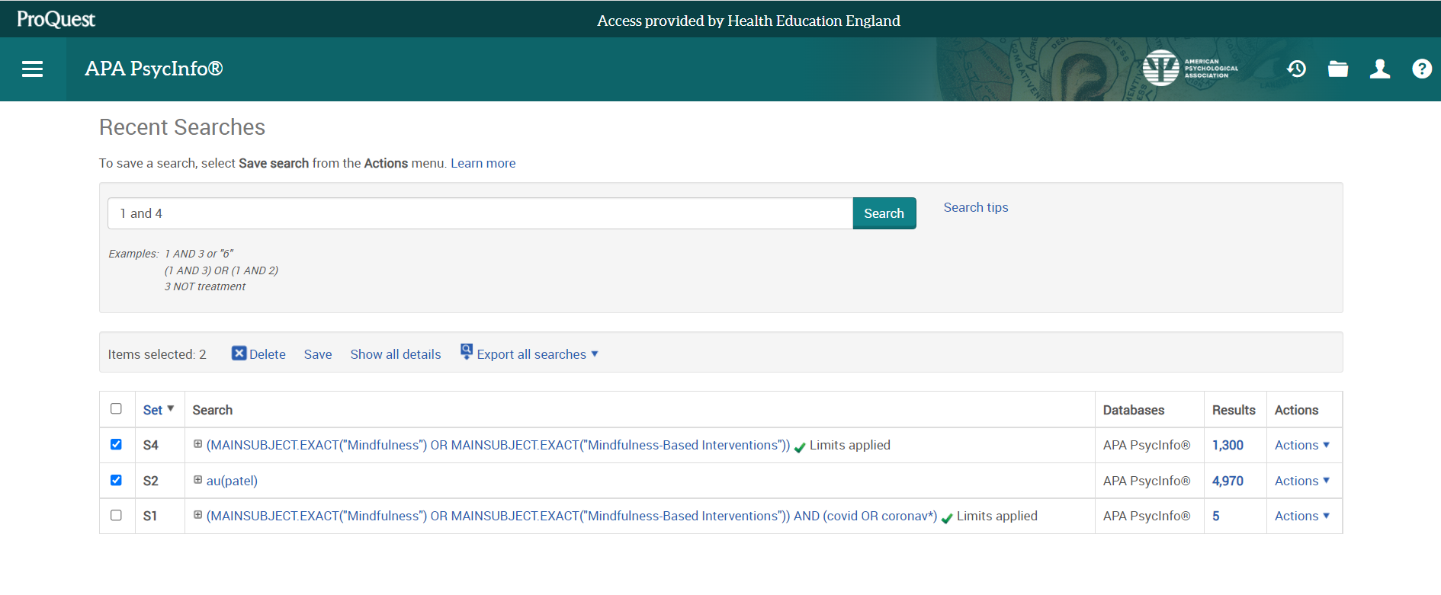
Combining your searches
Notes:
Alternatively, you can carry out individual searches then go to Recent Searches to combine lines.
Identify the lines you want to combine and key those search line numbers into the search box using the appropriate operator (AND, OR or NOT). The examples will show you the correct format.
Click Search when you’re done.

Slide 46
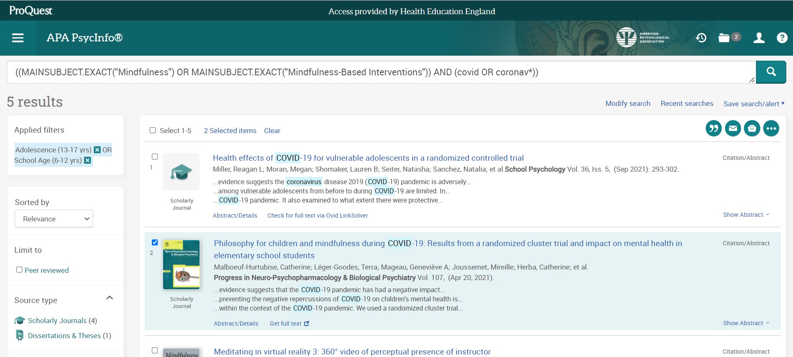
Refining and reviewing your results
Notes:
You can also apply limits after you’ve done a search. Use the left hand menu to add in limits eg by publication date. In this example, the initial search has been limited by age group to school age children OR adolescence.
Use the tick boxes to pick the records most relevant to your search.
Click Show Abstract to show the abstract
Use the Email, Save and other export options to save your search results, including to reference management tools. You can also export results from your folder at the top of the screen

Slide 47
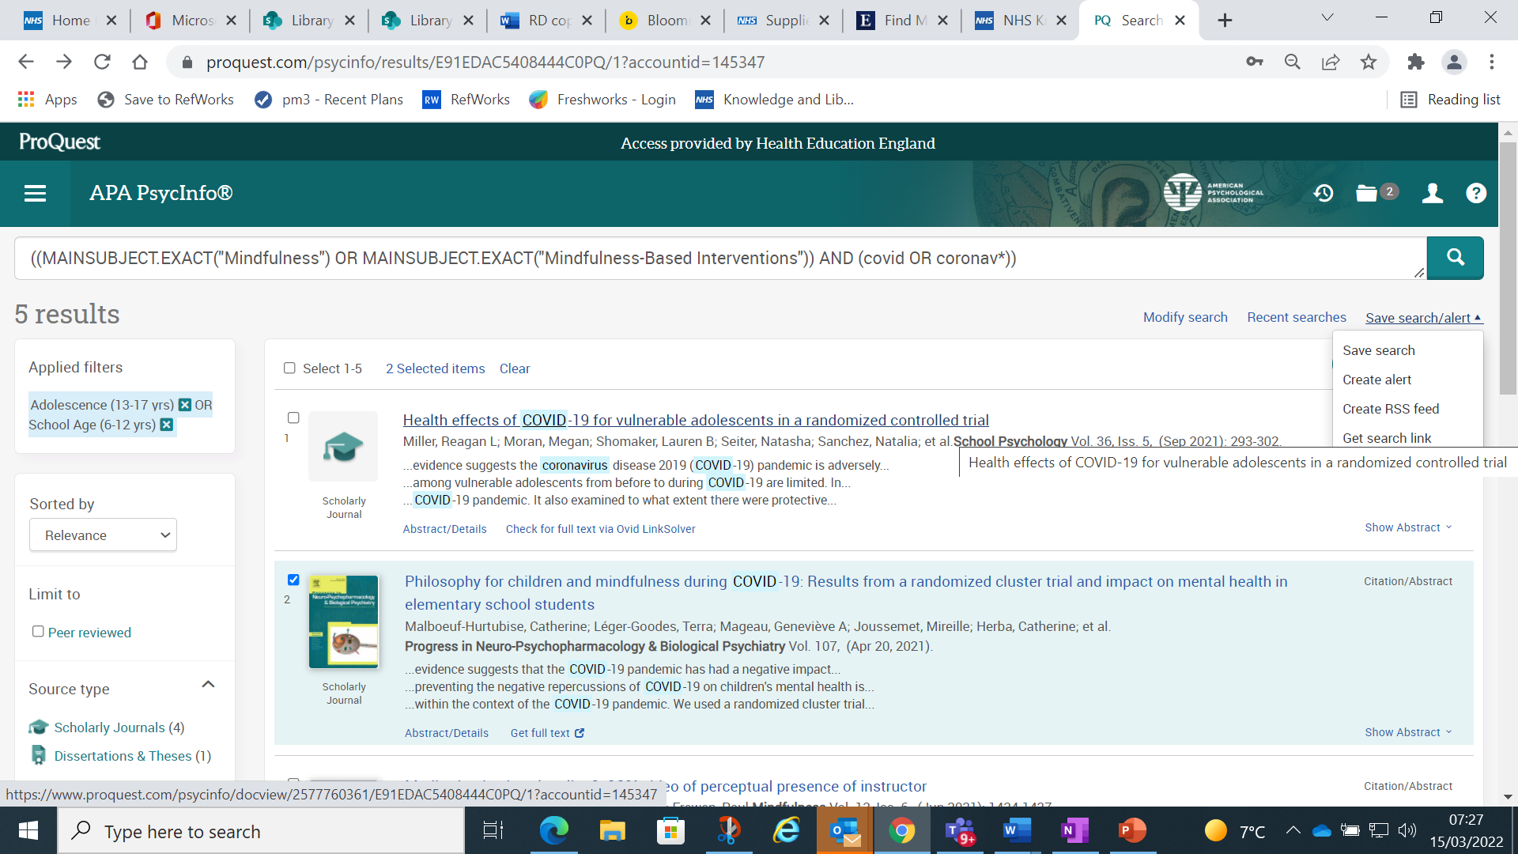
Saving your search history
Notes:
Click on Save search/alert to save your search history or create an alert which will email you when any new material is added to the database that matches your search

Slide 48
For more information
Go to
https://library.nhs.uk/knowledgehub/resources-for-advanced-searching/

